Slide 1
iPark
Kaustubh Sinha, Saket Vaibhav

Slide 2
User home page
Search button click flow:
Duration selection
Date view (monthly) and time selection from when to when in two rotating adjustable time wheels (like suitcase lock)
Click select location to confirm time and go to next page
New page with location search bar, google map api and a radial distance search, clicking search shows the clients within the selected range.
Persist with region
Selecting a client opens client details page with client information such as client's welcome message, certifications, features, history and rate etc.
The go back to persisting location page or select another client.
Then when the client is selected, proceed with booking page: showing total and asking for payment information (allow for card information saving and using the checkbox for that payment) allow + option to add new card always.
Proceed with payment. (not sure how those pages work after se ding payment info.
Show client's pre-written welcome message and parking instructions once payment is confirmed along with an option to check the receipt on the top right or left under a separate button(allow download).
Search button
For lookup into public parking
Favourites button
Transit button
History
Settings
For quick bookings

Slide 3
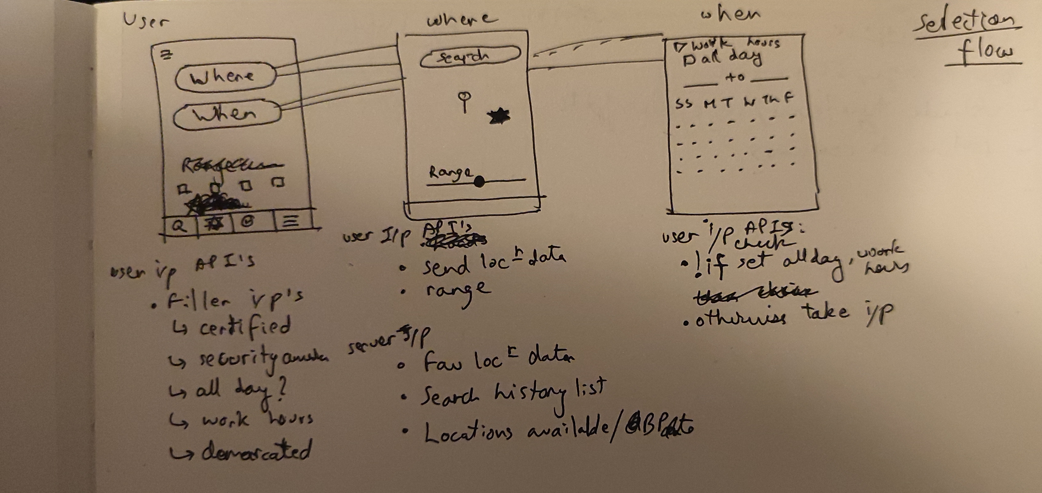
An example of User flow (as described in the last slide)
‘when‘ should come before ‘where’

Slide 4
History and Favourites page flow
Multiple entries for
history - past reservations
Multiple entries for
favourites - locations and durations
List name
Show client/ user attributes
Show date, duration of booking
Option to check receipt (downloadable PDF table)
List name
Show client/ user attributes
Show location
Option to see history with client

Slide 5
Client home page
Reservations
Current
If there’s a car on any of the hosted listings
Upcoming
Upcoming reservations:
Either after current one on the same lisitng
or earliest one on any of the lisitngs
Manage
Edit listing attributes such as:
Camera on site
Person monitoring on site
demarcated area
close to transit etc.
Earnings history (add a sound when this opens)
Past reservations (duration completed and charged)
Settings
User settings for profile information
Listing (s) here since this would also lead to a page to select listings from a dropwdown and edit the selected one accordingly. Hence it may be a class with attributes
Current
Upcoming
Manage listing (s)
History
Settings

Slide 6
User profile details
Ask them for the following details on signup:
- Full name
- Selfie photo with a clear background (mention that its required to verify the driving license ID)
- email
- phone(optional)
- driving license photo
- car model, make, color and license/ OR a clear back photo which captures all these details
- ratings and reviews
Details visible to client before deal:
First name, second initial
Vehicle make (size and type)
User’s rating history
Frequent booker tag
Details visible to client after deal
Booking details (time, duration and charges split)
Driver’s license (if requested)
Vehicle details (if requested)

Slide 7
Client profile details
Client details to enter
Name, age
ID verification
Listing(s) (class attributes)
Camera available on site?
Daily booking available
Recurring/ long term bookings available
Multi-slot hosting (Client type may change based on number of parking spaces threshold -> here revenue model would be different from an independent client -> eventually expect private parking companies to enroll here during scale up)
Details visible to User before deal:
First name, second initial
Listing size and location
Listing’s rate
Client’s exposed attributes
Client’s availability attributes
Client’s welcome message to user
Details visible to user after deal
Client name
Listing location on gMaps
Client’s booking info to user

Slide 8
Loyalty model for clients (focus here)+ hosts
Bonus scoring system = Loyalty factor + feedback rating
Bonus scores can give badges that help clients earn more over time, bringing more business to us and over-time giving more control to the client
Goal of the bonus scoring system is to show long-term clients will get to take home larger shares, and the app will only take an ‘ad hosting fee’ so clients become their own ‘ business owners’.
Some badges can be spent to invite or merge with other client(s) or transfer include another parking slot at the same ”bonus score level”.
(list more ideas here)

